Slide 1
The Conservation of Energy for Rigid Body Systems
Dr. Jacob Moore
Associate Professor of Engineering
Penn State Mont Alto

Slide 2
Work and Energy Method
The work energy method is best summarized as this...
“The work done to a system will be equal to the change in the system’s energy”
Work is...
A force applied over a distance
Energy is...
Translational or Rotational Kinetic Energy
Gravitational or Elastic Potential Energy (a replacement for work done by gravity forces or work done by elastic / spring forces)

Slide 3
The Conservation of Energy
If we put all of the pieces together in a single equation, we wind up with the conservation of energy equation.
$$W=∆KE+∆PE$$
All work an energy equations will start with this simple equation, which will be adapted based on what we know.

Slide 4
Conservation of Energy for Particles Review
For particles, we had the following basic definitions…
Work: | $W=F∗d$ or $W=\int{F(x) dx}$
Change in Kinetic Energy: | $$∆KE=\frac{1}{2}m{v_{f}}^{2}−\frac{1}{2}m{v_{i}}^{2}$$
Change in Gravitational Potential Energy: | $$∆PE=mg∆h$$
Change in Elastic Potential Energy: | $$∆PE=\frac{1}{2}k{x_{f}}^{2}−\frac{1}{2}k{x_{i}}^{2}$$

Slide 5
Work and Energy for Rigid Bodies
With rigid bodies, we now allow for rotation.
We will still be using the formula:
$$W=∆KE+ ∆PE$$
Now however we will also need to include
The work done by moments/couples, as a new part of work.
Rotational kinetic energy, as a new part of the kinetic energy.
Torsional spring energies

Slide 6
Work of a Moment
The work done by a moment exerted on a rigid body will be...
$$W=M ∗ ∆θ$$
Where...
W is the work done
M is the magnitude of the moment
$∆θ$ is the change in angle of the rigid body (in radians).
Just as with forces and translational motion, the work of a moment is only the vector component of the moment that lines up with the vector component of the rotation.
Moments that oppose rotation will be negative work

Slide 7


$$F_{push}$$
$$Moment$$
$$Vector$$
θ
θ
Displacement
Axis of
Rotation

Slide 8
Work of a Moment
Also as with forces, if the moment varies with position, you can integrate the moment over the angle of displacement to find the overall moment.
$$W=\int_{θ min}^{θ max}{M(θ) dθ}$$
$$M$$
M$\left(θ\right)= …$
$$θ$$

Slide 9
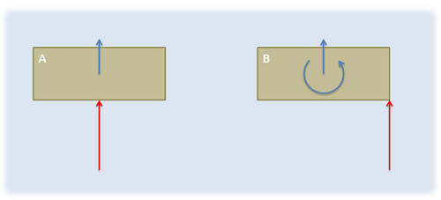
Work in Rigid Body Systems
It’s also important to note that since a single, off-center force can cause a force and a moment, a single force can also do linear work and angular work.
$$W=(F∗d)+(M∗∆θ)$$

Slide 10
Rotational Kinetic Energy
The rotational kinetic energy is the kinetic energy stored up the relative motions of all the parts of a spinning body.
For fixed axis rotation:
$$KE=\frac{1}{2}I_{o}ω_{}^{2}$$
For changes in kinetic energy we have:
$$∆KE=\frac{1}{2}I_{o}ω_{f}^{2}−\frac{1}{2}I_{o}ω_{i}^{2}$$
For fixed axis rotation, you want to find everything relative to the center of rotation.
$$ω$$
Center of Rotation (O)

Slide 11
Kinetic Energy for General Planar Motion (Rotation and Translation)
If we have both rotational and translational motion, the change kinetic energy will be the summation of the energies of the two types of motion.
$$∆KE=\left(\frac{1}{2}mv_{f}^{2}−\frac{1}{2}mv_{i}^{2}\right)+\left(\frac{1}{2}I_{G}ω_{f}^{2}−\frac{1}{2}I_{G}ω_{i}^{2}\right)$$
Note that the velocity is the is the velocity of the center of mass and the mass moment of inertia is taken about the center of mass
$$ω$$
$$v$$

Slide 12
Gravitational Potential Energy
For changes in gravitational potential energy it is important to measure the change in height of the center of mass of the object
$$∆PE=mg∆h$$
$$∆h$$

Slide 13
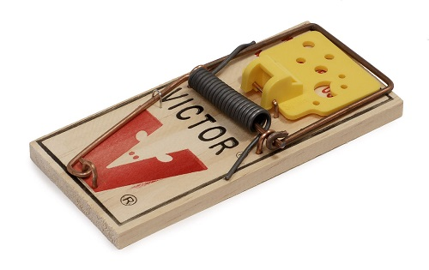
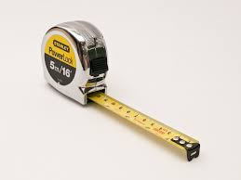
Torsional Springs
Finally under elastic potential energy for rigid bodies, we can have not only regular (linear) springs, but also torsional springs.
The change in elastic potential energy for a torsional spring is…
$$∆PE=\left(\frac{1}{2}kθ_{f}^{2}−\frac{1}{2}kθ_{i}^{2}\right)$$
k is the spring constant of the torsional spring
$θ$ is the angle the spring is deformed from its resting position
Image by William Warby
CC-BY-SA 4.0

Slide 14
Work and Energy Methods and Kinematics
One of the primary limitations of the work and energy method, is that it only results in a single equation.
Because we only have a single equation to work with, it is very important to be able to relate all the motions to one another using kinematics
Linear and angular velocities
Positions and displacements for potential energies

Slide 15





initial state
$$ω_{i}$$
final state
$$v_{i}$$
$$ω_{f}$$
$$v_{f}$$
$$∆h$$

Slide 16
Solving a Work and Energy Problem (The Process)
Solving a work and energy involves three steps, carefully accounting for the factors at play between some initial state and some final state.
Set up one diagram showing the initial state and set up some other diagram for the final state.
Identify any forces or moments that will do work between the two states
Identify the known or unknown velocities and angular velocities in each state
Identify the change in height if applicable
Identify the ‘x’ and ‘$θ$’ values for springs in the initial and final states if applicable
Use the diagram to put together the single conservation of energy equation, with included known and unknown values.
$W=∆KE+∆PE$
If you have more than one unknown you will need to come up with additional equations relating the unknowns you have.
Solve the equations for the unknown quantities

Slide 17
Thanks for Watching
See other engineering mechanics videos and access the full tool at…

Slide 18
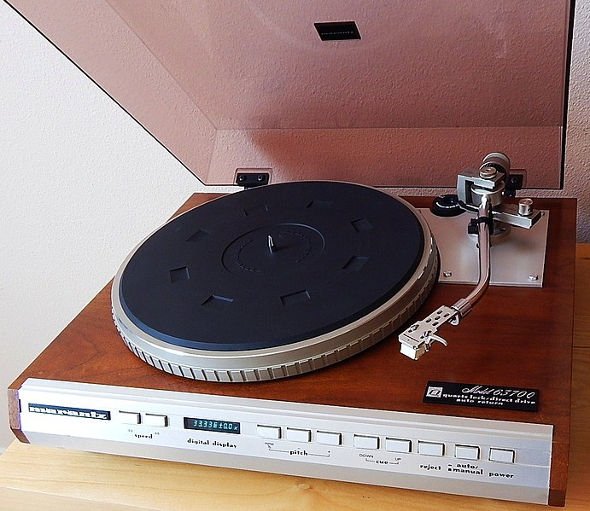
Worked Example
The turntable on a record player consists of a disk 12 in in diameter with a weight of 5lbs. If the motor accelerates the turntable from rest to it’s operating speed of 33.33 rpm in one rotation.
Determine:
The work done by the motor.
The torque of the motor exerts.

Slide 19
Worked Example
A system as shown below is used to passively slow the lowering of a gate. The gate can be approximated as a flat plate on its edge with a mass of 25 kg and a height of 2m.
What would the angular velocity of the gate be without the spring?
If we want to reduce the angular velocity at the bottom to 25% of it’s original value what should the spring constant be? Assume the spring is upstretched as shown in the diagram.
1m
.7m
1m

Slide 20
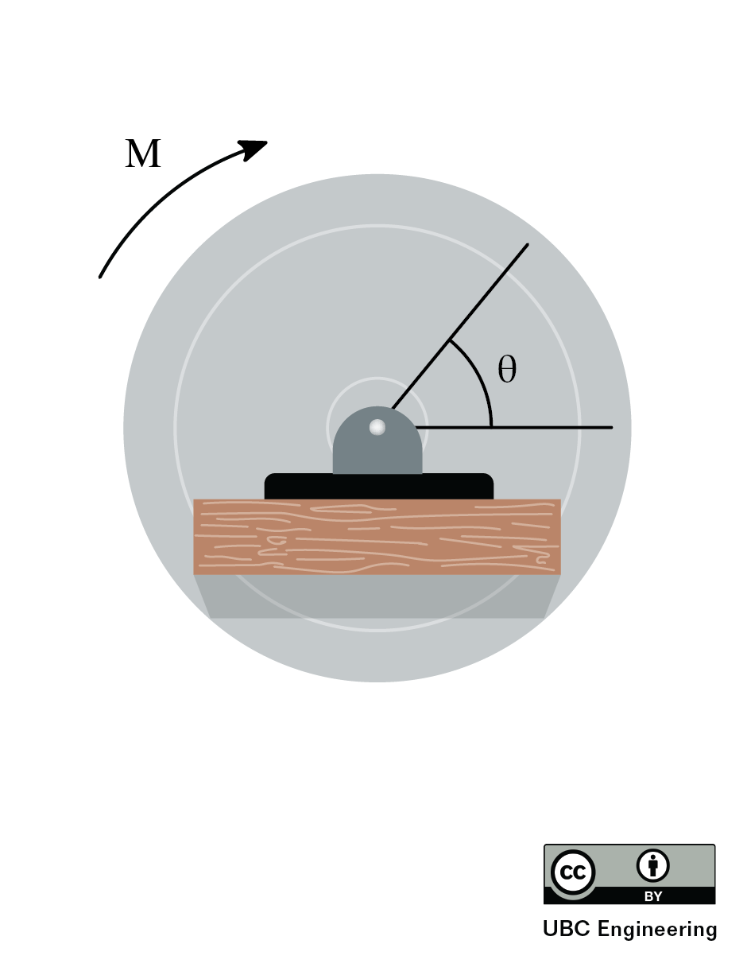
Worked Example
If a couple moment M=(θ²+2θ+2)Nm is applied to a disk, determine the work of the couple moment after the disk has rotated 4 times. What would be the sign of the work if the moment was applied in the opposite direction?

Slide 21
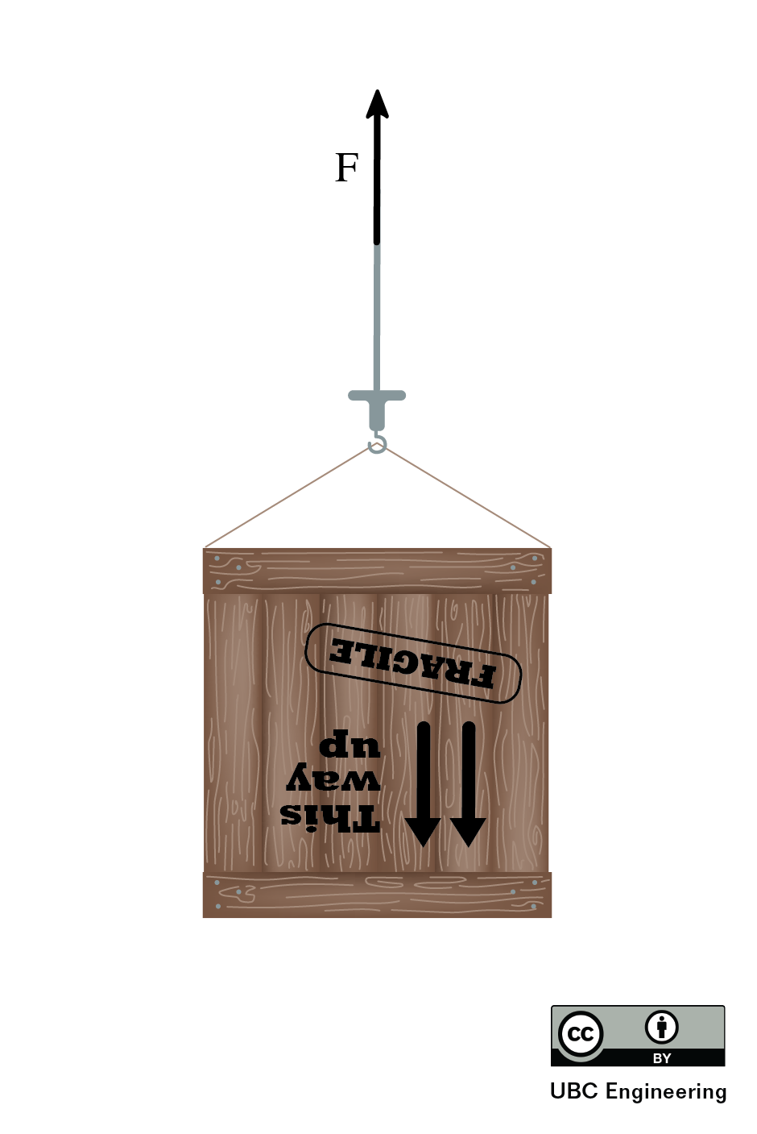
Worked Example
A crane lifts a crate with mass 30kg using a cable. If the crane applies a force of 400N and lifts it up to a height of 5m, determine the work done by both the crane and gravity, and the crate’s final velocity if it started from rest.

Slide 22
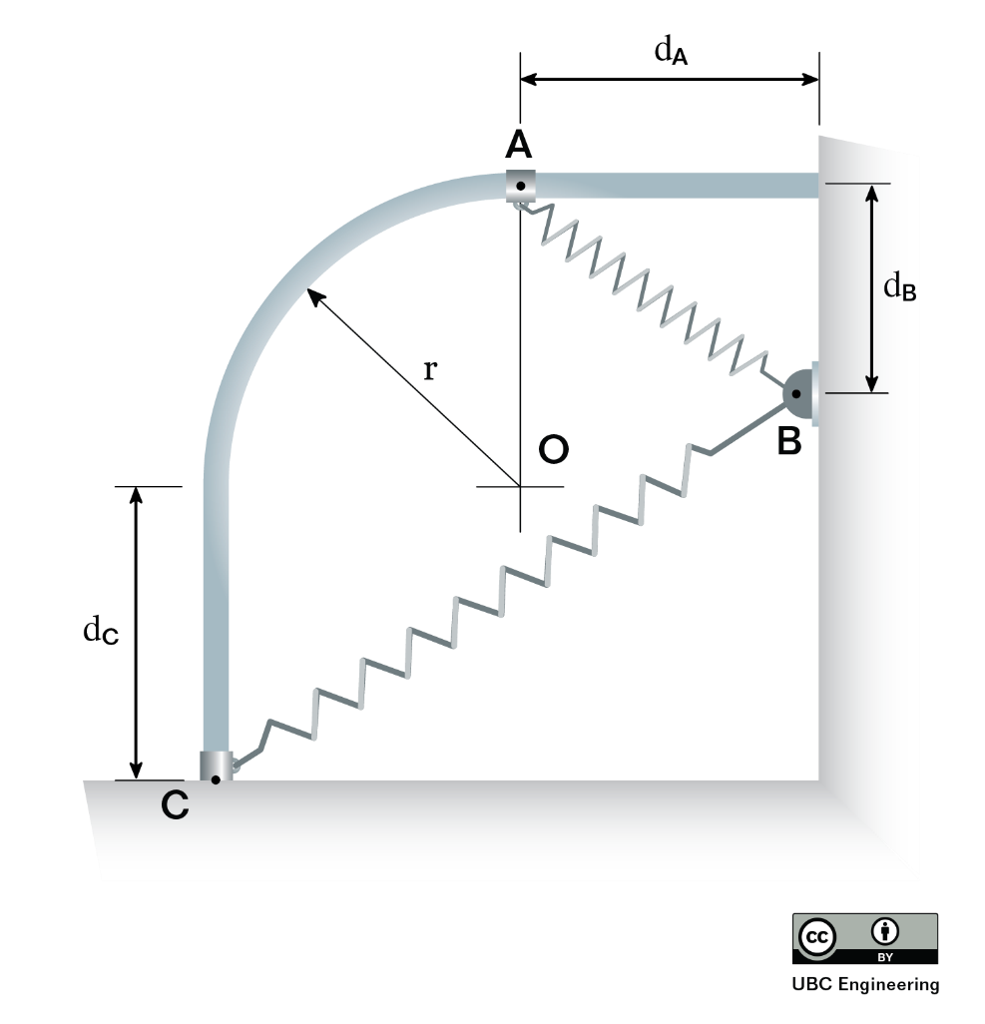
Worked Example
Find the potential energy at point A and at point C. Determine which location has greater potential energy. The collar has mass m=0.8kg and the spring has a constant k=600 N/m. Point A is located a horizontal distance of d_{A}=0.6m away from the wall while point C is located a vertical distance of d_{C}=1.3 m below point O on the diagram. Point B is located a vertical distance d_{B}=0.9 m below point A and the track has a radius r=0.2 m. The unstretched length of the spring is l₀=0.12 m.

Slide 23
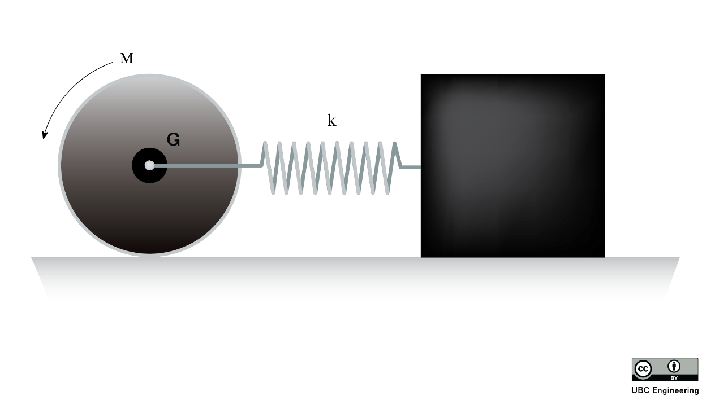
Worked Example
A lazy engineer is designing a robot to move things for him. He places a hub motor inside a 2.5 kg disk such that a couple moment of M=2.943 Nm is applied. If the attached package has a mass m=5 Kg and the coefficients of kinetic friction and static friction for between all objects are μ_{k}=0.2 and μ_{s}=0.4 respectively, determine the angular velocity of the disk after its center of mass has travelled a distance d=0.5 m. Assume the disk rolls without slipping and the package does not tip. The disk has a radius r=0.3 m, the spring constant is k=100 N/m and the spring is unstretched originally.

Slide 24
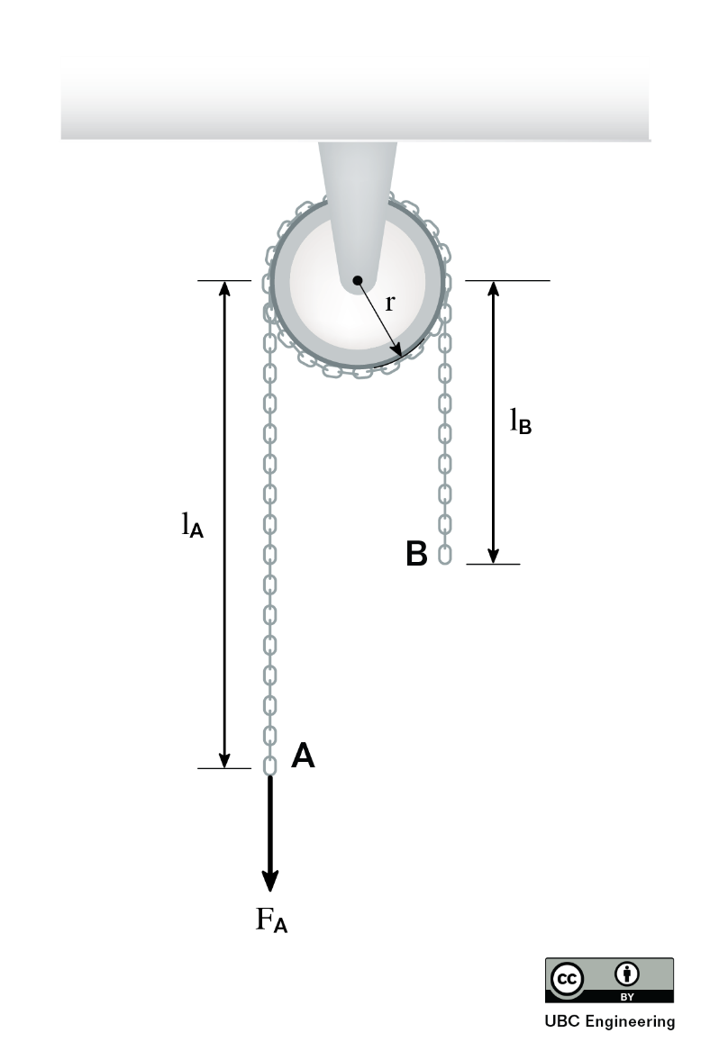
Worked Example
For a summer, you’ve taken a job at your uncle’s auto shop. You pull on the left side of a chain wrapped around a pulley with a force of F=50 N. The pulley has a mass m=20 Kg and a radius r=0.2 m. If the chain has a mass of 3.4 Kg/m, determine the angular velocity of the pulley after it has rotated θ=90 degrees. There is l_{A}=3 m of chain hanging off the left side and l_{B}=2 m hanging off the right side of the pulley. Assume the chain does not slip and that the system was released from rest just before you pulled on it. Assume the pulley can be modelled as a disk.

Slide 25
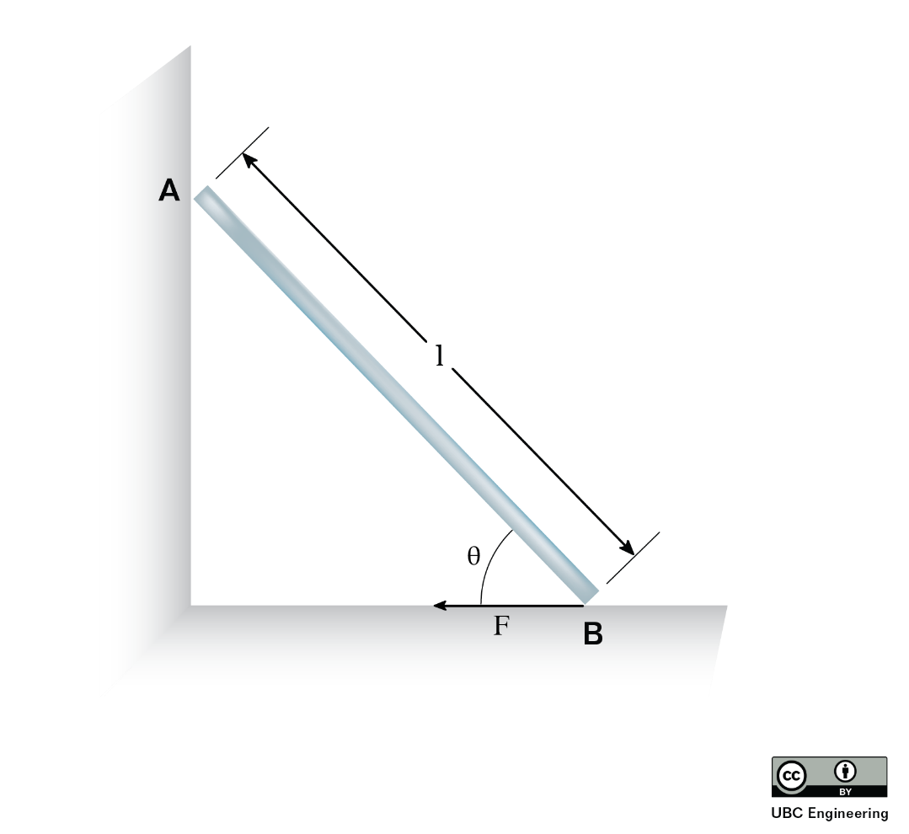
Worked Example
A 30kg sheet of ice with length l=1.5 m at an angle θ=30 degrees has a force F=650 N applied at B. Determine the magnitude of the angular velocity of the plank when it reaches a vertical position. Assume the sheet acts like a thin plate and that contact between the sheet and all surfaces is frictionless.

